Slide 1


Accelerating Data Insights with AWS:
S3, Glue, Redshift, and QuickSight
Guddge LLC
www.guddge.com
www.guddge.org

Slide 2

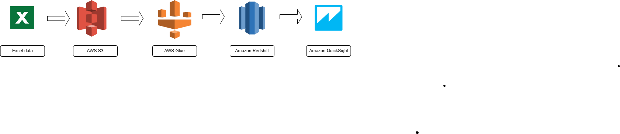

Introduction & Overview
Introduction
In today's data-driven business environment, deriving quick and accurate insights from vast amounts of data is crucial. AWS offers a robust suite of services that create a seamless data pipeline from storage to visualization. This paper explores a typical data analytics scenario using AWS S3, Glue, Redshift, and QuickSight.
Scenario Overview
An infrastructure company needs to analyze large volumes of data to gain insights into maintenance plans, item details, span lengths, pipeline diameters, and anniversary information. The data is scattered across multiple sources in various formats.
Data Processing Pipeline
© 2024 Guddge, LLC

Slide 3
AWS: S3
AWS S3: Scalable Data Storage
Amazon S3 serves as the foundation for storing raw data.
It offers scalable, secure, and highly available storage, capable of handling large datasets.
Create a "redshift-lab-001" bucket with "Input" and "Output" folders.
Place the "Bridges and spans report" in the Input folder.
© 2024 Guddge, LLC

Slide 4
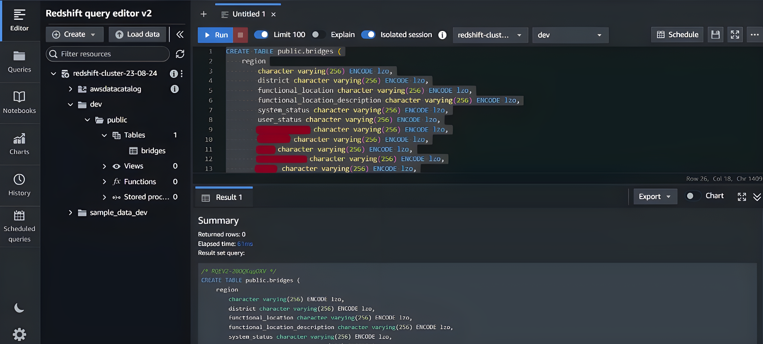
AWS Redshift
AWS Redshift: Data Warehousing and Querying
Amazon Redshift enables complex SQL queries across large datasets with minimal latency, allowing for advanced analytics and comprehensive insights.
Create a Redshift cluster named "Redshift-cluster-23-08-24".
Use the Redshift query editor to create a "bridges" table.
No data will be present in it, if you run it.
© 2024 Guddge, LLC

Slide 5
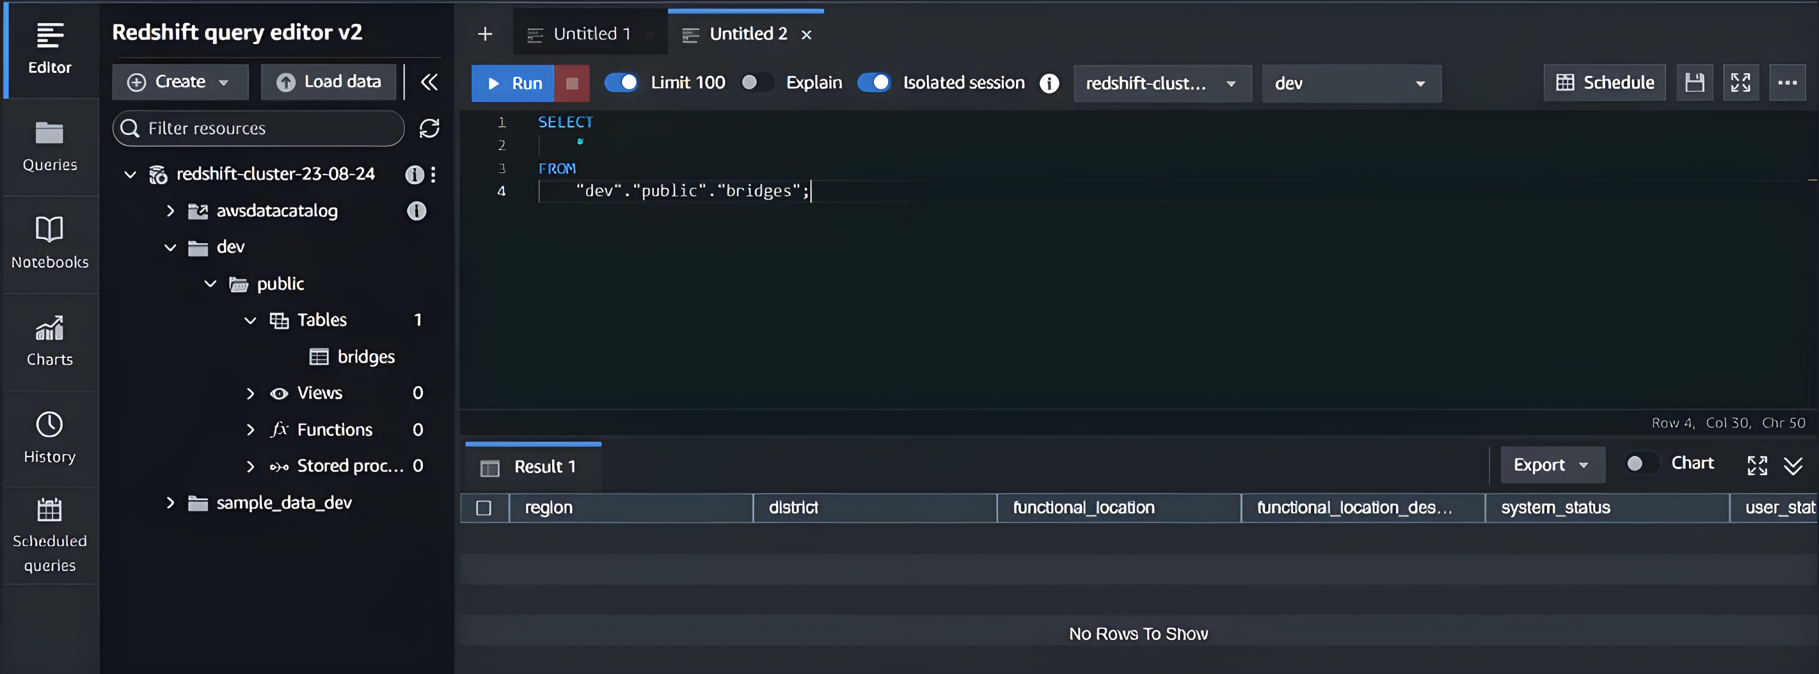
AWS Redshift Cont.
© 2024 Guddge, LLC

Slide 6
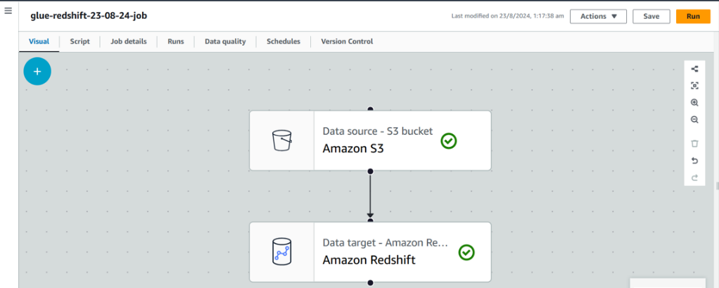
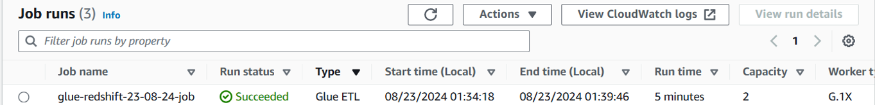
AWS Glue
AWS Glue: Data Integration and Transformation
AWS Glue automates the process of discovering, cataloging, and transforming data.
Create and run a Glue Crawler to populate the Glue Data Catalog.
Create a connection linking Glue and Redshift.
Create and run an ETL job named "glue-redshift-23-08-24-job".
© 2024 Guddge, LLC

Slide 7
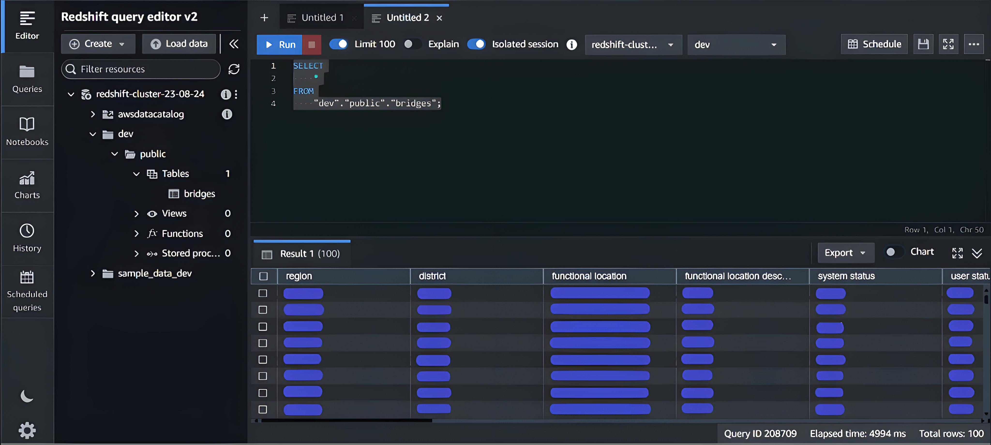
AWS Glue Cont.
After the ETL process, data from S3 is successfully loaded into Redshift.
© 2024 Guddge, LLC

Slide 8
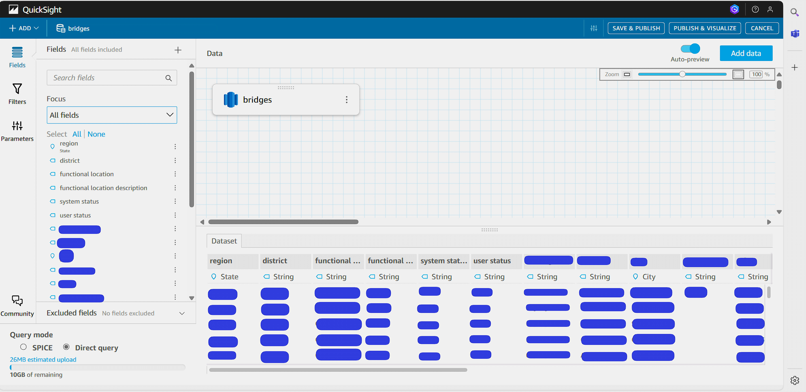
AWS QuickSight
AWS QuickSight: Data Visualization and Reporting
Amazon QuickSight creates interactive dashboards and reports based on the data stored in Redshift.
Open QuickSight and create a new dataset connecting to Redshift.
Create visualizations and dashboards using the imported data.
© 2024 Guddge, LLC

Slide 9
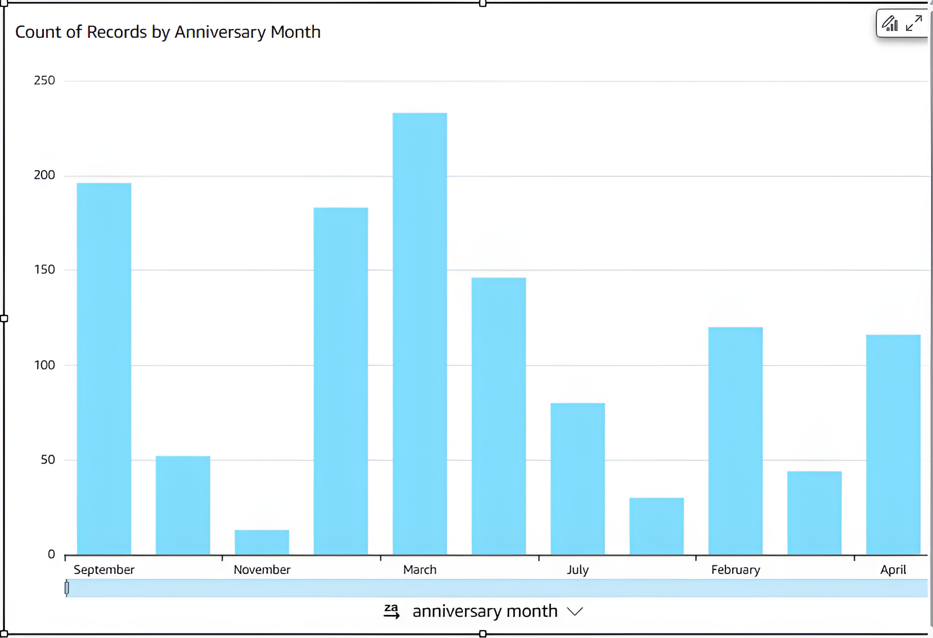
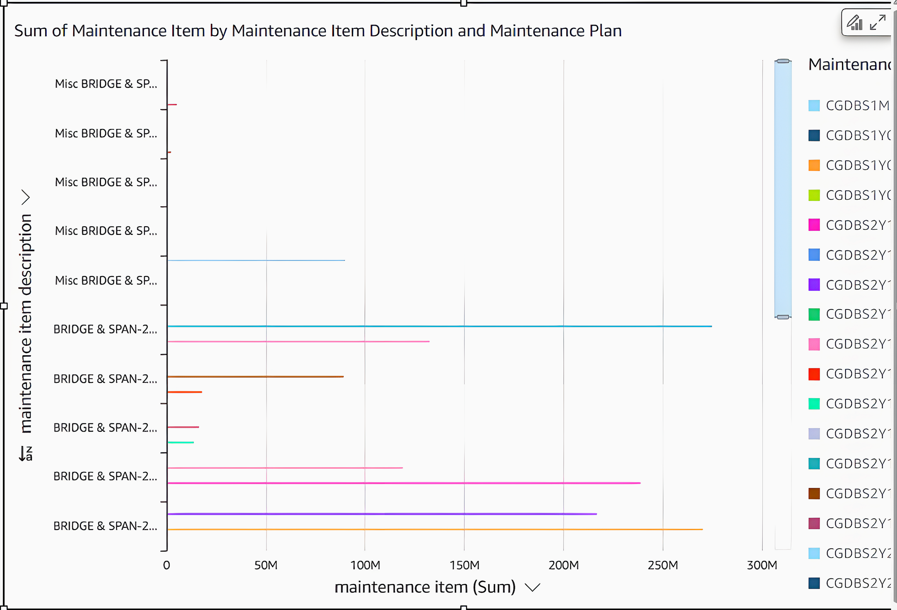
AWS QuickSight Cont.
Sample Visualizations
© 2024 Guddge, LLC

Slide 10
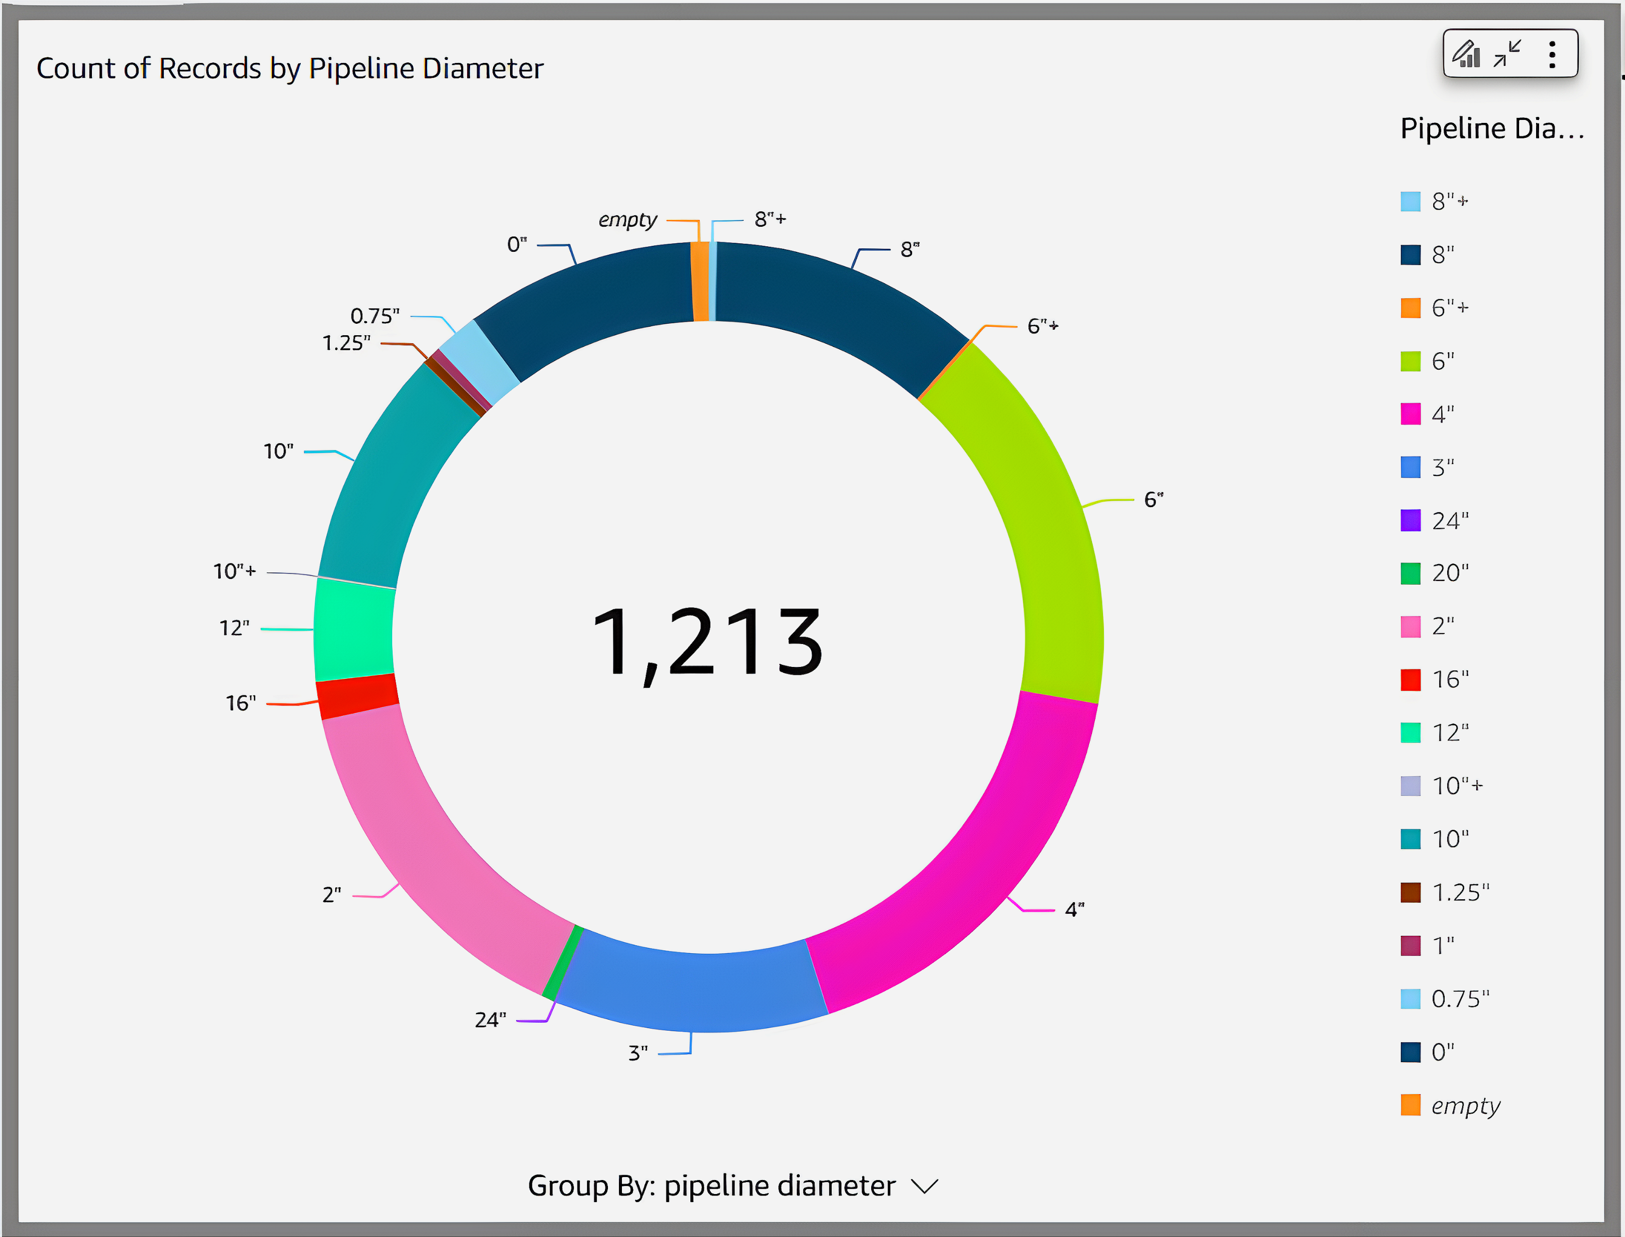
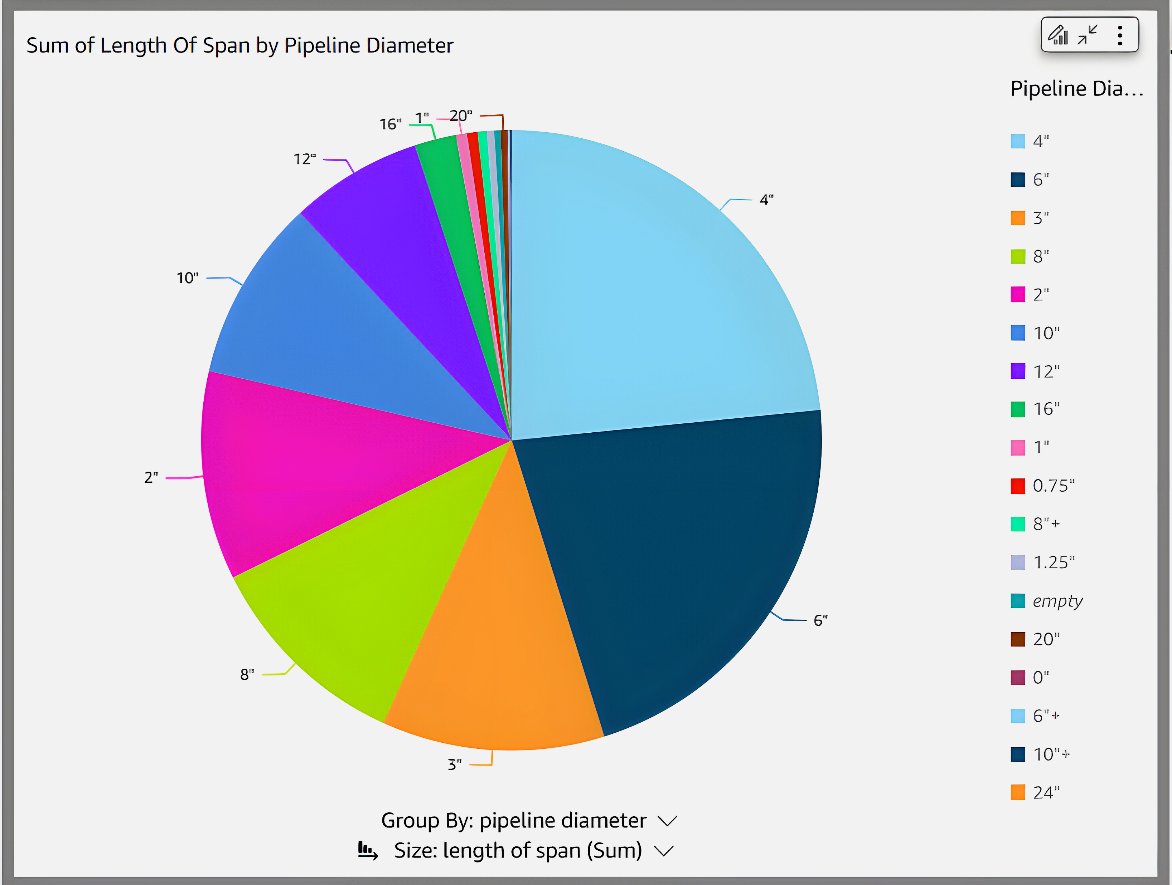
AWS QuickSight Cont. 2
Sample Visualizations
© 2024 Guddge, LLC

Slide 11
QuickSight Capabilities
Emerging Capabilities in Amazon QuickSight:
Amazon QuickSight Q: QuickSight Q allows users to ask natural language questions and receive accurate answers with relevant visualizations, making data analysis more accessible.
Complex Visualizations: QuickSight is evolving to support increasingly complex visualizations, enabling users to gain deeper insights from their data with customizable and interactive dashboards.
Diverse Data Sources: It supports a wide range of data sources, ensuring that businesses can integrate and analyze data from various platforms, including cloud and on-premises databases, seamlessly.
© 2024 Guddge, LLC

Slide 12
QuickSight Capabilities
Estimate Summary : Calculated by AWS Pricing Calculator
Upfront Cost | Monthly Cost | Total 12 Months Cost
0.00 USD | 115.76 USD + QuickSight Charges | 1389.12 USD + (QuickSight charges) Includes Upfront Cost
Detailed Estimate:
Name | Region | Configuration Summary | Monthly Cost(USD)
S3 | US East (N. Virginia) | S3 Standard Storage (500GB) | 11.50
AWS Glue | US East (N. Virginia) | Number of DPUs for apache spark job (5) Number of DPUs for Python Shell job (0.0625) Number of crawlers (1) | 13.01
Amazon Redshift | US East (N. Virginia) | Nodes (1) Instance type (dc2.large) Utilization (On-Demand only) (50% Utilized/Month) Pricing Strategy (OnDemand) | 91.25
Amazon QuickSight | US East (N. Virginia) | Author ($ 24 per user/month) Reader ($ 3 per user/month) Usage based pricing(Reader Capacity from $250 For 500 Sessions/Month) Spice charge($0.38 per GB/Month) | Based on what you choose
© 2024 Guddge, LLC

Slide 13
References & Conclusion
Reference details regarding Pricing
AWS S3: https://aws.amazon.com/s3/pricing/
AWS Glue: https://aws.amazon.com/glue/pricing/
Amazon Redshift: https://aws.amazon.com/redshift/pricing/
AWS QuickSight: https://aws.amazon.com/quicksight/pricing/?p=pm&c=aa&pd=qs&z=4
Conclusion
By leveraging AWS S3, Glue, Redshift, and QuickSight, companies can establish an efficient data pipeline that transforms raw data into valuable business insights. This integrated approach reduces time and resources required for data management and analysis while enhancing the accuracy and relevance of generated insights. The result is a more agile and informed business strategy that drives growth and profitability.
© 2024 Guddge, LLC

Slide 14

Thank you!
Website: guddge.com
Contact: sales@guddge.com

